Slide 1


A comparison of hepatitis E and A in a teaching hospital in Northwestern Romania
Acute hepatitis E – a mild disease?
Amanda Rădulescu ^{MD, PhD} ● Alexandru Istrate ^{Md}

Slide 2
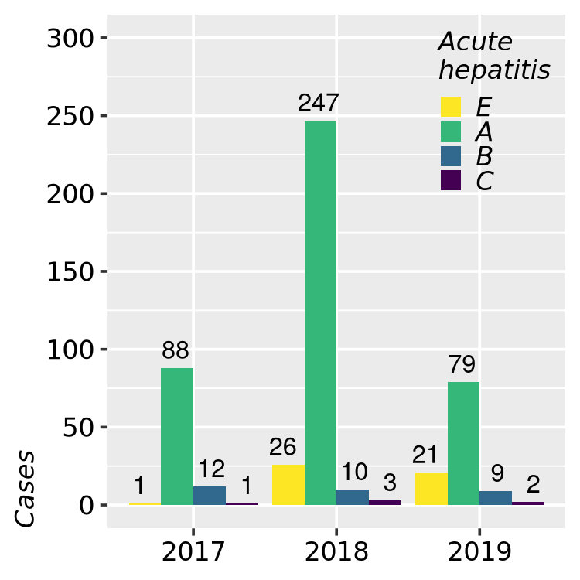
Background
HEV incidence in Europe / Romania
Notes:
The incidence of locally acquired hepatitis E increased in recent years across Europe. There are only a few data on hepatitis E in Romania.

Slide 3
Objectives
Describe and compare hepatitis E and hepatitis A in adult patients.

Slide 4
Methods
Retrospective, case-case
We included all consecutive adult patients with
hepatitis E (IMC10: B17.2) and
hepatitis A (IMC10: B15.*) admitted in
the Teaching Hospital of Infectious Diseases,
Cluj-Napoca, Romania
during January 2017 - August 2019.
Case definition of acute viral hepatitis:
clinical & laboratory criteria
serological testing
epidemiological criteria

Slide 5
Methods: severe cases
Hepatitis E*
Hepatitis A*
INR >1.5
hepatic encephalopathy grades 2-4
comorbidities (acute-on-chronic liver disease, confirmed immunosuppression)
neurological manifestations
INR >1.5
hepatic encephalopathy grades 2-4
Supportive treatment plus
ribavirin (600-800 mg/day)
Supportive treatment plus
plasma products
* EASL 2018, hospital protocol
* EASL 2016, hospital protocol

Slide 6
Statistitical methods
Comparisons between hepatitis E and hepatitis A groups were performed using:
univariate methods (t-test for continuous variables with normal distribution according to the Shapiro-Wilk test, Mann-Whitney test for continuous variables with non-normal distribution, Fisher test for binary variables)
multivariate logistic regressions:
model 1: adjusting for age & gender
model 2: adjusting for comorbidities.

Slide 7
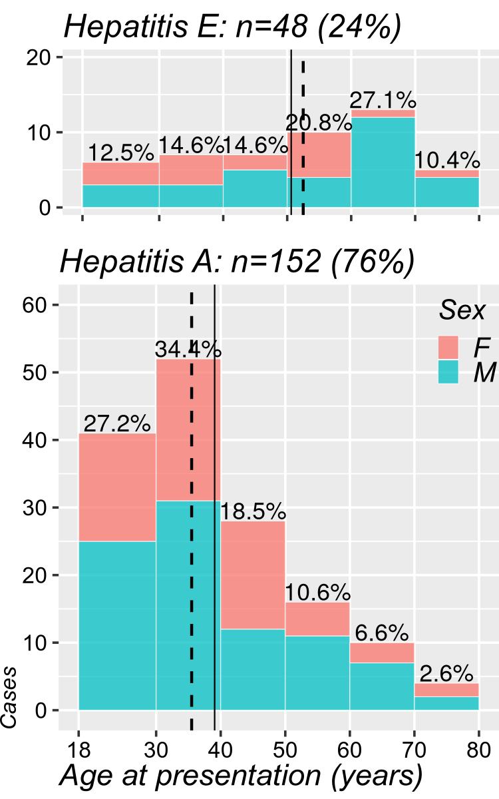
Results: demographics
Hepatitis: |  | E: n (%) | A: n (%) | p-value
 |  | 48 (24.0%) | 152 (76.0%)
Gender | M | 31 (64.6%) | 88 (57.9%) | ns.
 | F | 17 (35.4%) | 64 (42.1%)
Age at presentation (years) | Mean ±SD | 50.62 ±15.6 | 39.06 ±15.0 | p<0.001
 | 50+ | 28 (58.3%) | 31 (20.4%)
 | [40, 50) | 7 (14.6%) | 28 (18.4%)
 | [30, 40) | 7 (14.6%) | 52 (34.2%)
 | [18, 30) | 6 (12.5%) | 41 (27.0%)
Hospital stay duration (days) | Median (IQR) | 9 (7-14) | 11 (8-14) | ns.
Notes:
The average age in hepatitis E (n=48) patients was 50.6 versus 39.1 years in hepatitis A (n=152) and two thirds of the patients in both groups were men.

Slide 8
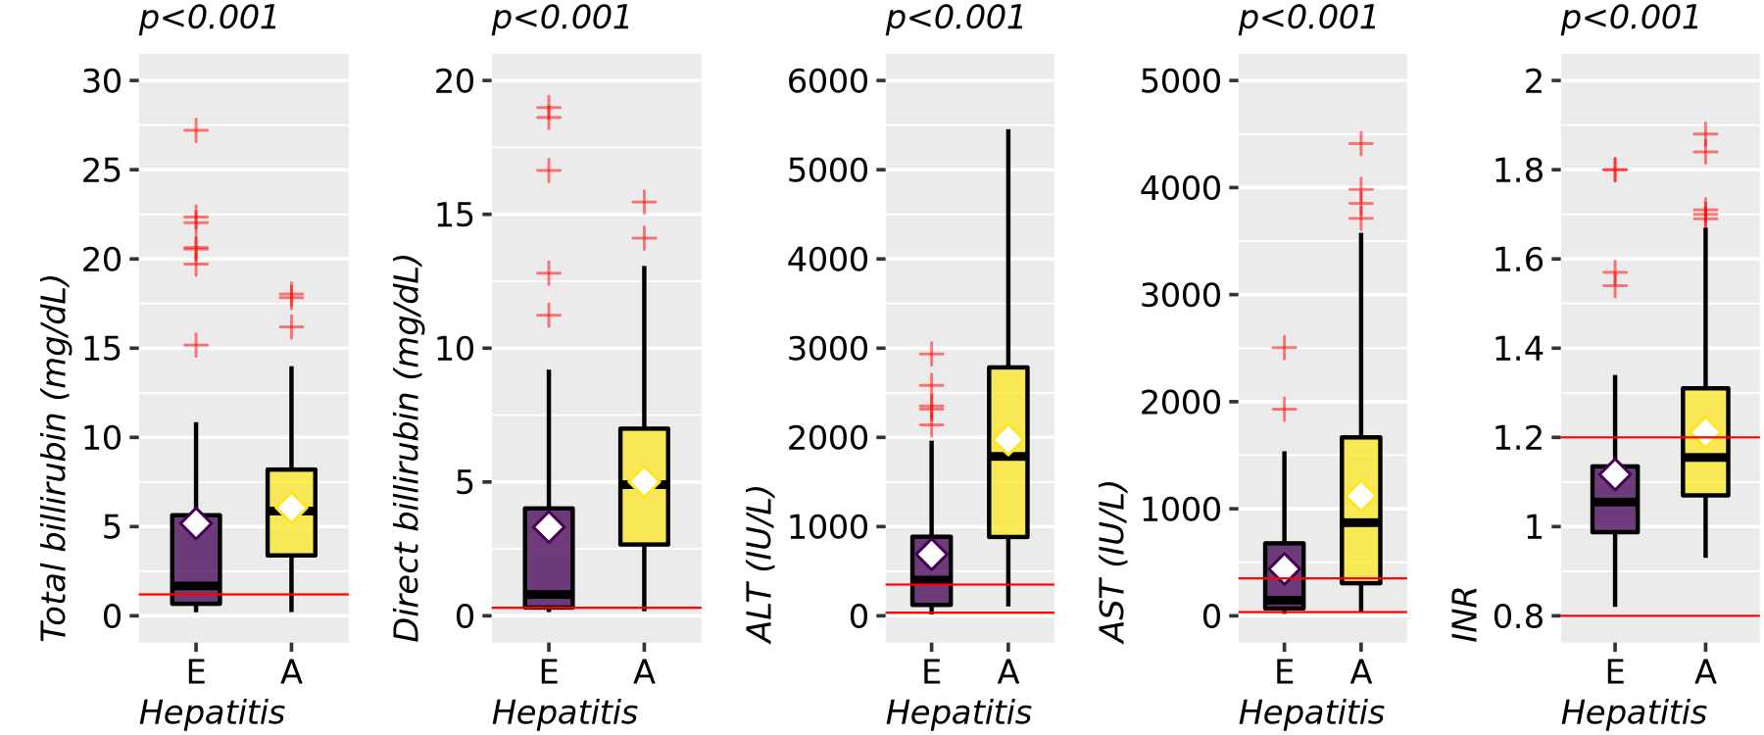
Results: liver function
Notes:
Compared to hepatitis A, patients with hepatitis E presented with significantly less modified bilirubin, transaminase and and INR levels.

Slide 9
Results: liver function
Hepatitis: Median (IQR) | E: n (%) | A: n (%) | Univariate statistics | Adjusted OR on age & gender [95% CI], p
 | 48 (24.0%) | 152 (76.0%)
AST (IU/L, log10) | 145.5 (69-676.75) | 870 (304.5-1666.75) | MW: p<0.001 | 0.112 [0.05, 0.23], p<0.001
> 350 | 17 (35.4%) | 99 (65.1%) | OR=0.29 [0.15, 0.58], p<0.001 | 0.249 [0.12, 0.51], p<0.001
ALT (IU/L, log10) | 401 (122.75-886.25) | 1817.5 (919.25-2801.75) | MW: p<0.001 | 0.045 [0.02, 0.11], p<0.001
> 350 | 26 (54.2%) | 132 (86.8%) | OR=0.18 [0.09, 0.37], p<0.001 | 0.12 [0.05, 0.27], p<0.001
Notes:
At admission, Transaminases showed only moderate increases in hepatits E patients with only one third for AST and half of the patients, for ALT, showing values 10 times larger that our laboratory's reference values. Both enzymes were significantly more increased in hepatitis A, regardless of age or gender.
both variables were transformed to base 10 logarithms before multivariate analysis, soodds-ratios reflect tenfold increases/decreases in the original laboratory values

Slide 10
Results: liver function
Hepatitis: Median (IQR) | E: n (%) | A: n (%) | Univariate statistics | Adjusted OR on age & gender [95% CI], p
 | 48 (24.0%) | 152 (76.0%)
Direct bilirubin (mg/dL, log10) | 1.24 (0.34-5.02) | 4.9 (2.66-6.99) | MW: p<0.001 | 0.194 [0.09, 0.38], p<0.001
Total bilirubin (mg/dL, log10) | 1.73 0.68-5.76) | 5.87 (3.38-8.2) | MW: p<0.001 | 0.182 [0.08, 0.39], p<0.001
ALP (IU/L, log10) | 154.5 (119.25-192.75) | 205 (159.25-260.5) | MW: p<0.001 | 0.046 [0.01, 0.34], p=0.003
γ-GT (IU/L, log10) | 229 (123.5-327) | 246 (154.75-355.5) | MW: ns. | 0.343 [0.12, 0.99], p<0.048
Notes:
Similarly, bilirubin values at admission were much lower than in hepatitis A patients. Alcaline phosphatase and gamma-GT values both had smaller increases in hepatitis E. Controlling for age and gender, all appear significantly less modified.

Slide 11
Results: hemostasis
Hepatitis: Median (IQR) | E: n (%) | A: n (%) | Univariate statistics | Adjusted OR on age & gender [95% CI], p
 | 48 (24.0%) | 152 (76.0%)
Prothrombin index (%) | 88.25 (75.2-100.38) | 72.7 (59.9-86.85) | T-test: p<0.001 | 1.039 [1.02, 1.06], p<0.001
< 70 | 9 (18.8%) | 60 (42.0%) | OR=0.32 [0.14, 0.71], p=0.005 | 0.268 [0.11, 0.61], p=0.002
INR | 1.06 (0.99-1.13) | 1.16 (1.07-1.31) | MW: p<0.001 | 0.036 [0.0, 0.26], p=0.002
> 1.5 | 4 (8.3%) | 16 (11.2%) | ns. | ns.
Notes:
Coagulation paramenters were also worse in hepatitis A patients, however coagulopathy with INR above 1.5, which required plasma products, was found in aproximatively 10% of the patients of both groups.

Slide 12
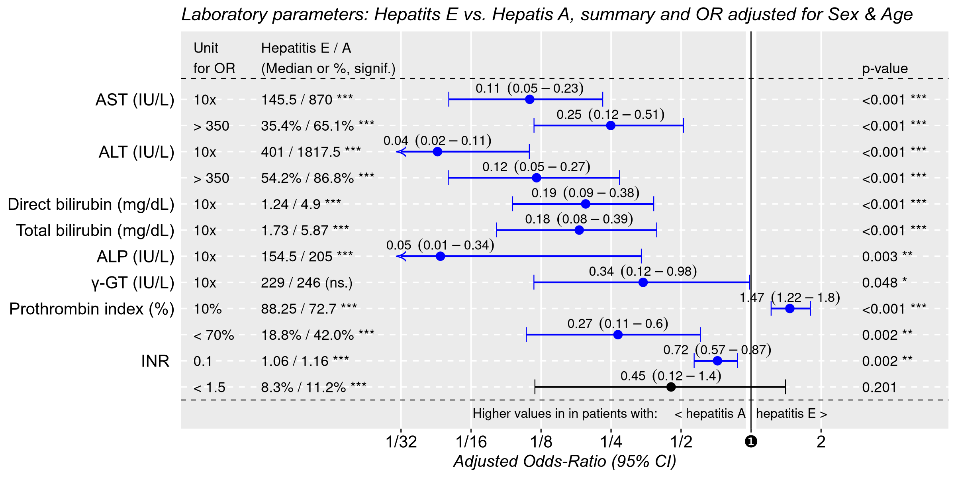
–●– Univariate, unadjusted
–●– Model 1: Adjusted for Age & Sex
Notes:
At admission, Transaminases showed only moderate increases in hepatits E patients with only one third for AST and half of the patients, for ALT, showing values 10 times larger that our laboratory's reference values. Both enzymes were significantly more increased in hepatitis A, regardless of age or gender.
both variables were transformed to base 10 logarithms before multivariate analysis, soodds-ratios reflect tenfold increases/decreases in the original laboratory values
Similarly, bilirubin values at admission were much lower than in hepatitis A patients. Alcaline phosphatase and gamma-GT values both had smaller increases in hepatitis E. Controlling for age and gender, all appear significantly less modified.
Coagulation paramenters were also worse in hepatitis A patients, however coagulopathy with INR above 1.5, which required plasma products, was found in aproximatively 10% of the patients of both groups.
For these, adjusted odds ratios are relative to every 10% and 0.1 points variations in prothrombin index and INR, respectively

Slide 13
Results: comorbidities
Hepatitis: n (%) | E: n (%) | A: n (%) | Univariate statistics OR [95% CI], p | Adjusted OR on age & gender [95% CI], p
 | 48 (24.0%) | 152 (76.0%)
Chronic liver disease | 13 (27.1%) | 6 (3.9%) | 9.04 [3.21, 25.45], p<0.001 | 7.19 [2.53, 22.73], p<0.001
of which:
Liver cirrhosis | 6 (12.5%) | 1 (0.7%) | 21.57 [2.53, 184.16], p<0.001 | 12.5 [1.86, 250], p=0.026
Hepatitis B coinfection | 6 (12.5%) | 4 (2.6%) | 5.29 [1.43, 19.60], p=0.014 | 6.71 [1.7, 29.41], p=0.007
Adjusted OR (on all comorbidites, incl. next tables) = 6.21 [2.0, 20.5], p=0.002
Notes:
We found a higher prevalence of comorbidities in hepatitis E patients, regardless of age & gender. 27% of hepatitis E patients and only 4% of hepatitis A patients had chronic liver diasase, relation that remains significant after controling for demographics or other comorbidities.
Of them, liver cirrhosis is especially prevalent in hepatitis E.

Slide 14
Results: comorbidities
Hepatitis: n (%) | E: n (%) | A: n (%) | Univariate statistics | Adjusted OR on age & gender [95% CI], p | Adjusted OR* on all comorbidites [95% CI], p
 | 48 (24.0%) | 152 (76.0%)
Neurologic disease | 6 (12.5%) | 2 (1.3%) | 10.71 [2.09, 55.04], p=0.003 | 9.52 [1.89, 71.43], p=0.011 | 4.76 [0.8, 38.3], p=0.098
Chronic kidney disease | 5 (10.4%) | 2 (1.3%) | 8.72 [1.63, 46.54], p=0.009 | 5.18 [0.99, 38.46], p=0.065 | 6.175 [0.99, 50.0], p=0.056
Diabetes mellitus | 10 (20.8%) | 9 (5.9%) | 4.18 [1.59, 11.02], p=0.004 | 2.04 [0.69, 5.99], p=0.190 | 3.39 [1.1, 10.1], p=0.029
* incl. next and previous tables
Notes:
We found other chronic comorbidities, more frequently in hepatitis E patients, all with rather impressive odds ratios. Adjusted for age and gender, only preexisting neurologic conditions remainined significatly associated more with hepatitis E with confidence intervals that bearly cross the neutrality line.

Slide 15
Results: additional treatment
Hepatitis: n (%) | E: n (%) | A: n (%) | Univariate statistics OR [95% CI], p | Adjusted OR on age & gender [95% CI], p
 | 48 (24.0%) | 152 (76.0%)
Additional treatment (in severe forms) | ribavirn: | plasma: | 6.78 [2.15, 21.40], p<0.001 | 4.93 [1.49, 17.86], p=0.010
 |  | 5 (3.3%)
 | 9 (18.8%)
Adjusted OR (on all comorbidites, incl. previous tables) = 4.47 [1.2, 17.25], p=0.025

Slide 16
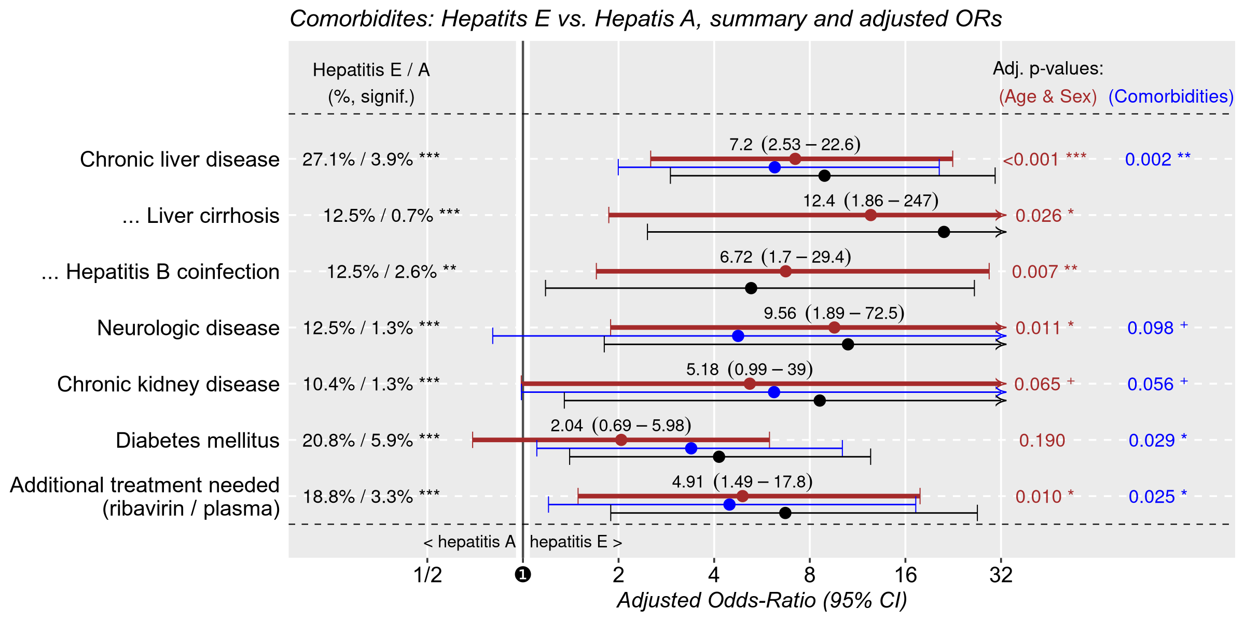
–●– Univariate, unadjusted
–●– Model 1: Adjusted for Age & Sex
–●– Model 2: Adjusted for Comorbidities
Notes:
We found a higher prevalence of comorbidities in hepatitis E patients, regardless of age & gender. 27% of hepatitis E patients and only 4% of hepatitis A patients had chronic liver diasase, relation that remains significant after controling for demographics or other comorbidities.
Of them, liver cirrhosis is especially prevalent in hepatitis E.
We found other chronic comorbidities, more frequently in hepatitis E patients, all with rather impressive odds ratios. Adjusted for age and gender, only preexisting neurologic conditions remainined significatly associated more with hepatitis E with confidence intervals that bearly cross the neutrality line.
Additional treatment was needed in 5 hepatitis A patients (where we administeted plasma pruducs) compared to 9 hepatitis E patients, where ribavirin was used.

Slide 17
Results: patients who received ribavirn
Age, Sex | Direct bilirubin (mg/dL) | AST, ALT (IU/L) | INR | Ribavirin treatment (days) | Evolution
51♀ | 28.51 → 21.51 | 36 → 59, 15 → 24 | 1.17 → 1.02 | 10 / presumably continued | Breast cancer, liver, lung and bone metastases | transferred
21♂ | 0.25 → 0.19 | 19 → 20, 75 → 35 | 0.92 → 0.99 | 12 / 21 | Sagittal sinus thrombosis, bilateral facial palsy, one episode of seizures | transferred
36♂ | 25.02 → 19.17 | 191 → 149, 322 → 214 | 1.27 → 1.41 | 21 / presumably continued | Chronic hepatitis B with advanced fibrosis, MELD=23 (19.6% at 3 months) | transferred
38♂ | 1.67 → 1.98 | 1010 → 147, 1750 → 607 | 1.12 → 1.02 | 12 / up to 3 months | Hodgkin lymphoma with chemotherapy, bone marrow transplantation
63♂ | 16.64 → 3.9 | 270 → 53, 865 → 80 | 1.34 → 1.36 | 7 / 7 | Coagulation deficiency factors VIII & IX, autoimmune hepatitis
64♂ | 0.27 → 0.32 | 321 → 74, 1014 → 332 | 0.99 → 0.96 | 14 / 21 | Retroperitoneal liposarcoma
69♂ | 1.31 → 0.81 | 570 → 85, 436 → 141 | 1.12 → 1.01 | 2 / 15 | Newly diagnosed colon cancer, diabetes mellitus
74♂ | 0.67 → 1.16 | 460 → 37, 1013 → 219 | 1.06 → 0.96 | 21 / 21 | Ethanolic liver cirrhosis, Alzheimer and vascular and dementia, diabetes mellitus, MELD=7 (1.9% at 3 months)
75♂ | 24.1 → 7.11 | 645 → 44, 374 → 23 | 1.57 → 1.38 | 19 / 21 (thrombocytopenia) | Newly diagnosed ethanolic liver cirrhosis and hepatocarcinoma, MELD=24 (19.6% at 3 months) | transferred
Notes:
All hepatitis E patients who received ribavirin had favorable evolution and were either discharged at home or to another department for specialized treatment for their comorbidities.
A short course of ribavirin treatment, was considered for these patients and we observed good results. There was a tendency for normalization of laboratory parameters.
Ribavirin treatment was stopped after 19 days in this patient due to severe thrombocytopenia. Two patients were transferred to other clinics where their treatment was presumably continued.
One severely immunosuppressed patient was recommended 3 months but showed good results within the first 12 days.

Slide 18
Results: deceased
Age, Sex | Direct bilirubin (mg/dL) | AST, ALT (IU/L) | INR | Preexisting conditions (interpreted as causes of death) | MELD score (3-months risk of death)
59♂ | 18.99 → 28.3 | 618 → 73, 262 → 16.6 | 1.8 → 4.15 | Hemorrhagic shock from esophageal varices, alcoholic liver cirrhosis (Child-Pugh C) | 35 (52.6%)
61♂ | 12.8 → 23.71 | 1537 → 253, 526 → 39.9 | 1.8 → 1.81 | Hemorrhagic shock from esophageal varices, alcoholic liver cirrhosis (Child-Pugh C) | 27 (19.6%)
65♂ | 4.92 → 14.51 | 157 → 23, 50 → 56.4 | 1.54 → 1.37 | Multiple system organ failure, alcoholic and hepatitis B viral cirrhosis (Child-Pugh B), endocarditis, cerebral embolism | 31 (52.6%)
Notes:
The three deceased patients all had hepatitis E infection on top of end-stage alcoholic liver disease and none of them received ribavirin because of severe thrombocytopenia.
They represented 6.25% of all hepatitis E patients and 23.1% of hepatitis E patients with preexisting liver disease.
Two of them died because of bleeding from esophageal varices. The third patient, with chronic hepatitis B infection and endocarditis died because of cerebral hemorrhage, septic cerebral embolism and multiple system organ failure.

Slide 19
Conclusions
Hepatitis E patients:
less modified laboratory parameters compared to hepatitis A
more frequent in older patients with preexisting conditions
which seems to lead to a higher number of severe and fatal cases
Ribavirin treatment may be beneficial in patients with
acute-on-chronic liver disease and / or immunosuppression
further studies are required to demonstrate its effect.

Slide 20
Thank you!

